Slide 1
Progress Updates on Position Estimation for Fault Diagnosis Purpose
Zhe Zhang, Rakesh Mitra, Prerit Pramod
Future Engineering
05/11/2016

Slide 2
Position Estimation for PMSMs ̵̶̵̵̵̵ Progress
Approaches have been tried:
Application | Principle | Technique
Mid-high speed | Back-EMF | Sliding Mode Observer Flux Observer
Zero-low speed | Motor Saliency/Asymmetry | Signal Injection, Saliency Detection
Zero-low speed | Active Disturbance Injection | Pulsating Signal Injection, Disturbance Detection

Slide 3
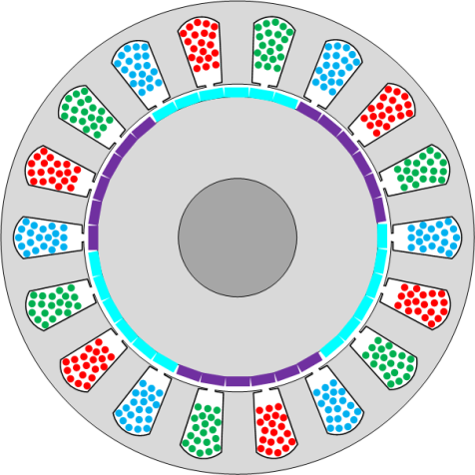
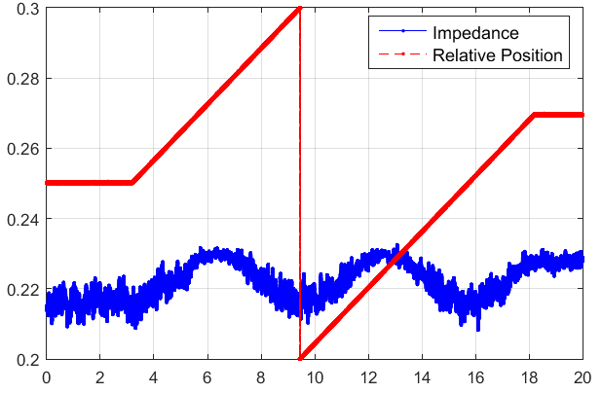
PMSM Magnetic Pole Identification ̵̶̵̵̵̵ Exploration of Signal Injection
d-axis
LWR PMSM is a surface mounted PMSM.
Theoretically, there is no saliency on such motors.
L_{d} = L_{q} = L_{s.}
q-axis
Signal Injection axis
With High Frequency Signal Injection (HFI):
S
N
S
SPM
q-axis
q-axis
d-axis
d-axis
The saliency on LWR PMSM is small.
L_{d} < L_{q}
Inductance difference is less than 2 uH.

Slide 4
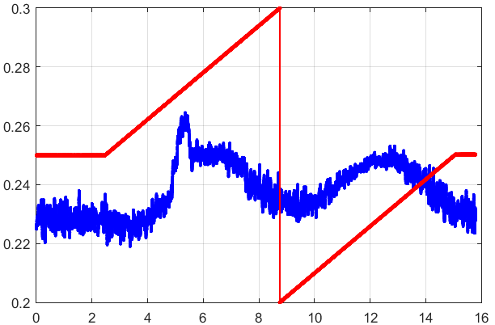
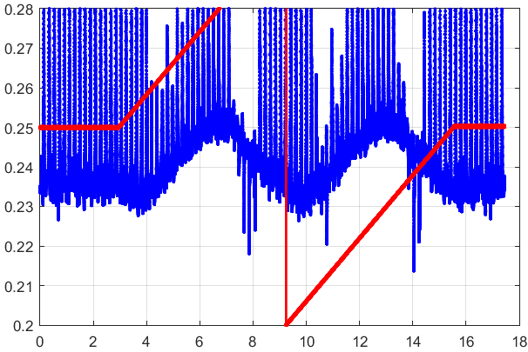
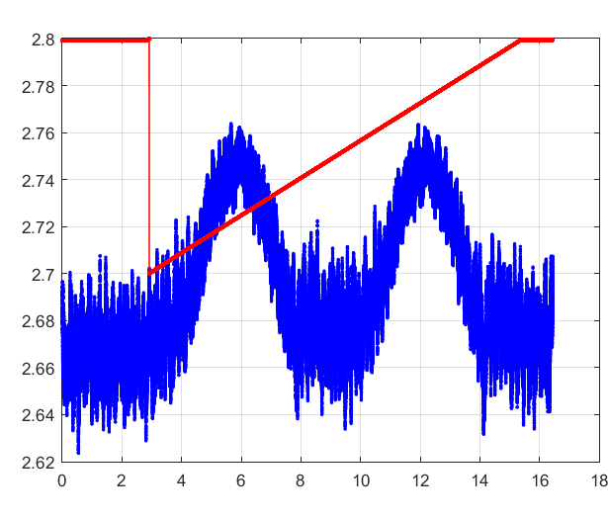
PMSM Magnetic Pole Identification ̵̶̵̵̵̵ Consistency
Applied HFI on another LWR PMSM
Small saliency exists on both LWR PMSMs.
Saliency is expected on all LWR PMSMs in one batch.
Not sure if this is true on other production motors.

Slide 5
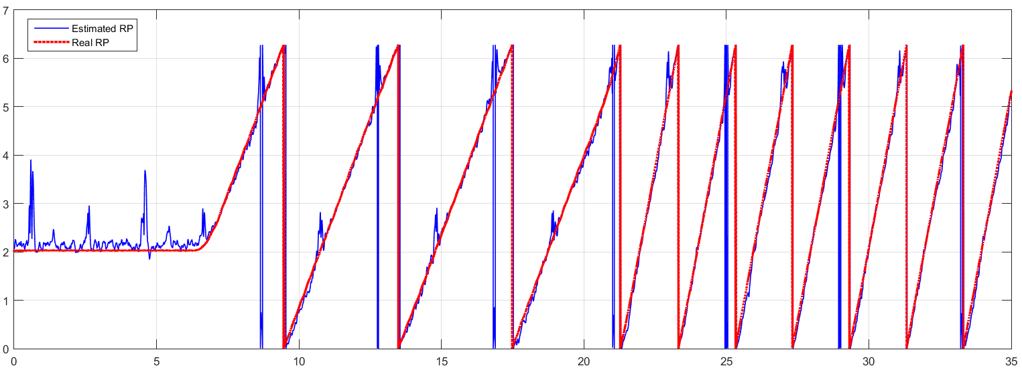
PMSM Magnetic Pole Identification ̵̶̵̵̵̵ Validation on dSPACE
Rotor Position Estimation based on HFI.
Rotor Speed: 0, 10, 20 RPMs.
Estimated rotor position vs. Real position
Challenges:
Signal to noise ratio, current measurement accuracy
Low saliency

Slide 6
PMSM Magnetic Pole Identification ̵̶̵̵̵̵ Active Disturbance Injection
Basic Idea: Creating low-frequency disturbances to make the motor spin back and forth.
Speed disturbance
Constant speed
ω_{e}
d-axis
fake d
Torque will be generated when the two axis are not aligned.
Zero speed when two axis are aligned.

Slide 7
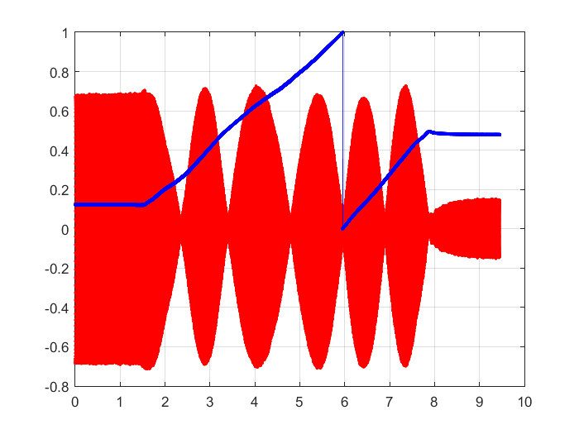
PMSM Magnetic Pole Identification ̵̶̵̵̵̵ Active Disturbance Injection Features

Slide 8
EPS Position Sensorless Control ̵̶̵̵̵̵ Plan and Timeline
Estimated completion date is based on presently allocated resources and schedules.
Manhours are estimated given a team of at least 5 engineers, including 3 motor control engineer, 1 control specific software engineer and 1 hardware engineer.
Milestone | Estimated Completion Date | Manhours
Position estimation on mid-high speed range | 05-31-2016 | 4 mons × 20 days × 4 eng × 4 hrs/day = 1280 manhours
Diagnosis function on mid-high speed operation | 07-31-2016 | 2 mons × 20 days × 4 eng × 4 hrs/day = 640 manhours
Position estimation for SPM on zero-low speed range | 12-31-2016* | 4 mons × 20 days × 4 eng × 6 hrs/day = 1920 manhours
Diagnosis function on zero-low speed operation | 02-28-2017** | 2 mons × 20 days × 4 eng × 4 hrs/day = 640 manhours
Low cost sensor assisted approach | 06-30-2017 | 4 mons × 20 days × 4 eng × 4 hrs/day = 1280 manhours***
* Plan may be changed due to the complexity of this scenario
** Plans for other approaches, e.g., system-level solutions, are not included in this table
*** Given support from sensor and motor design engineers

